Slide 1
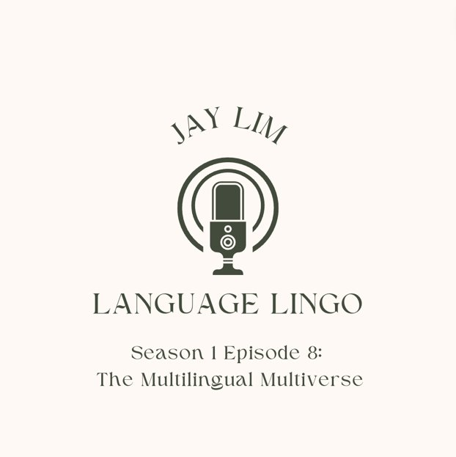
OMAA Conference 2024
‘The Multilingual Archive of Australia’ - Student Project
Presented by Jay Lim
(jlim0668@uni.sydney.edu.au)

Slide 2
Language Lingo: The Multilingual Multiverse
Podcast dedicated to discussions of linguistics, languages, global cultures and interconnectedness
Primary audience: Australian high-school students (Years 7-9, formative years of language learning)
Goal: to encourage the continued study of languages, exploration of multiculturalism in a techno-global world, discussion of cultural experience and hardship
Notes:
In this session, we will focus on defining homeostasis using examples of negative feedback loops
And describe how sensors and feedback system works to maintain the homeostasis
Finally we will look into how blood glucose is regulated with insulin and other hormones.

Slide 3
Key features
Podcast format → catering to shorter attention spans, audio-learning option as a preferred method of study
For the youth, by the youth → integration of relatable “fun facts” or pop-culture references to engage and entertain
Theory? Simple. Hotel? Trivago → simplified explanations of theory surrounding cultural hybridity and linguistic fusion
Notes:
In this session, we will focus on defining homeostasis using examples of negative feedback loops
And describe how sensors and feedback system works to maintain the homeostasis
Finally we will look into how blood glucose is regulated with insulin and other hormones.

Slide 4
Key features
Use of personal anecdotes surrounding cultural/ethnic confusion to provide reassurance and a space for youth minorities in similar circumstances
Recognition of English-centered academic environment → difficulty for those who wish to connect with and/or discover more about their cultures
Identity: as language-learners, as people of culture
Cultural exchange: conflict and connection
Notes:
In this session, we will focus on defining homeostasis using examples of negative feedback loops
And describe how sensors and feedback system works to maintain the homeostasis
Finally we will look into how blood glucose is regulated with insulin and other hormones.

Slide 5
Linguistic Theory: Bhabha and Bhatt
Homi Bhabha: linguistic, liminal ‘third space’
An “ambivalent space of cultural identity” that may “help us to overcome the exoticism of cultural diversity” (Mambrol)
Fusion cultures and linguistic hybridity
Histories of colonisation and imperalism
Rakesh Bhatt: the intricacy of code
Discussions of code-mixing and code-switching
Experience of immigrants and migrants in an English-dominant society
Notes:
In this session, we will focus on defining homeostasis using examples of negative feedback loops
And describe how sensors and feedback system works to maintain the homeostasis
Finally we will look into how blood glucose is regulated with insulin and other hormones.

Slide 6
The Multilingual Archives
Introduced as a learning tool → the aim is to present it as a useful ”website” specifically for school, additionally for personal interest
Simplified within project to avoid intimidation regarding the amount of information available
Credible, trustworthy sources, reliable information, variety of different languages available (students whose first languages may not be English)
Other fields: history, politics
Notes:
In this session, we will focus on defining homeostasis using examples of negative feedback loops
And describe how sensors and feedback system works to maintain the homeostasis
Finally we will look into how blood glucose is regulated with insulin and other hormones.

Slide 7
Thank you for listening 聞いてくれてありがとうございました 들어주셔서 감사합니다

