Slide 1
Diaspora
Promoting the multilingual archives of Australia to the next generation of linguists
Notes:
Bonjour et bienvenu a tous!
We'll be talking about...
How I constructed my project to promote the archives
Some of my favourite stories from the podcast
The links of the stories to linguistic hybridity

Slide 2
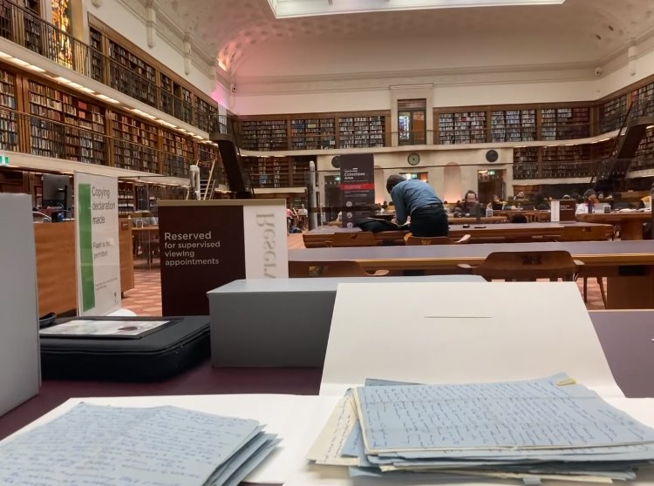
My project

Slide 3
The podcast
Diaspora: c'est votre podcast hebdomadaire sur l’Australie multiculturelle, où nous discutons de la cuisine fusion et de l’apprentissage des langues étrangères, ainsi que de l’évolution des modèles de migration en Australie, et du rôle économique qu’on joue dans la région Asie-Pacifique.

Slide 4
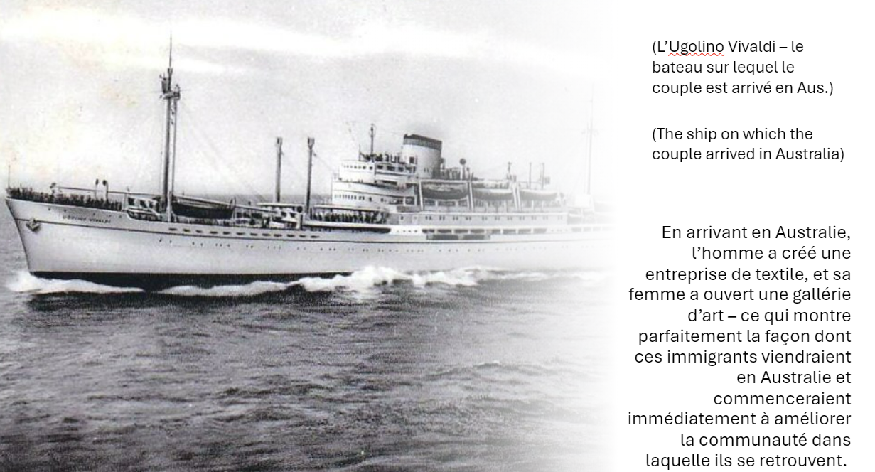
French captions
Notes:
Be sure to finish this slide by saying:
I'm now going to share with you some of my favourite stories from the podcast, which I'll tell in French, and then examine their theoretical implications in English.

Slide 5
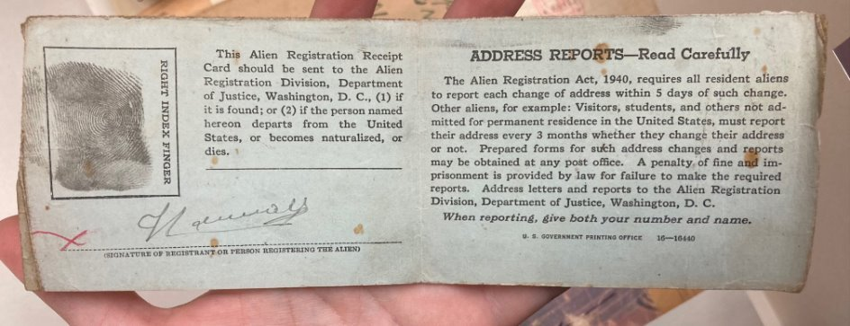

Slide 7
My favourite stories
1. The Fischl couple: English, French, Czech and German
1952-1980
2. The de Villentroy family: English and French
1880-1980
Told in French with English captions!

Slide 8
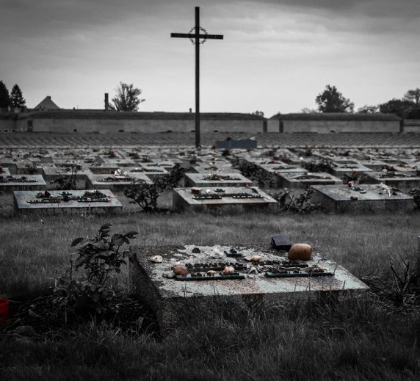
Story 1: the Fischl family
First, we’re going to talk about Mr Alexander and Mrs Milada Fischl, who arrived in Australia following WWII from Czechoslovakia, where they’d been imprisoned in a concentration camp for being Jewish, and unfortunately had lost their young child.
Upon arriving in Australia, the man founded a textile company and his wife opened an art gallery - this demonstrates perfectly how immigrants in this period would come to Australia and immediately start improving the community in which they found themselves.

Slide 9
Story 1: the Fischl family
But here’s a scandalous little detail! A man called Erwin Reiner, probably a German as he wrote in German and English, whom I identified by connecting the ‘E’ at the end of his letters to his name in the archive register, takes up a large part of this family’s archives, with his extensive love letters to Mrs Milada Fischl, which he would write several times a month from his apartment in London. It’s quite a different experience from watching a period drama on Netflix, if you get the chance to read the very handwriting of a real portfolio of scandalous letters!

Slide 11
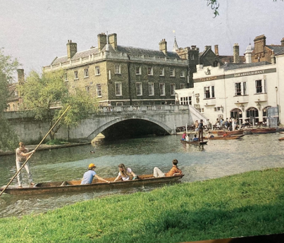
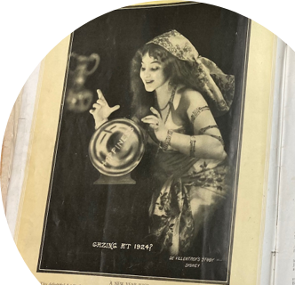
Story 2: the de Villentroy family
Now, we’re going to discuss a French family, de Villentroy, which emigrated from France at the end of the 19th century; and their archives stretch from the 1880s to the 1980s.
Mr Albert de Villentroy was a well-respected member of his community in Sydney - he was a photographer, and at the same time an able businessman - and it’s clear that many mourned his passing, as we have the postcards which his wife made to thank all his friends and family for the condolences they’d sent her.

Slide 12
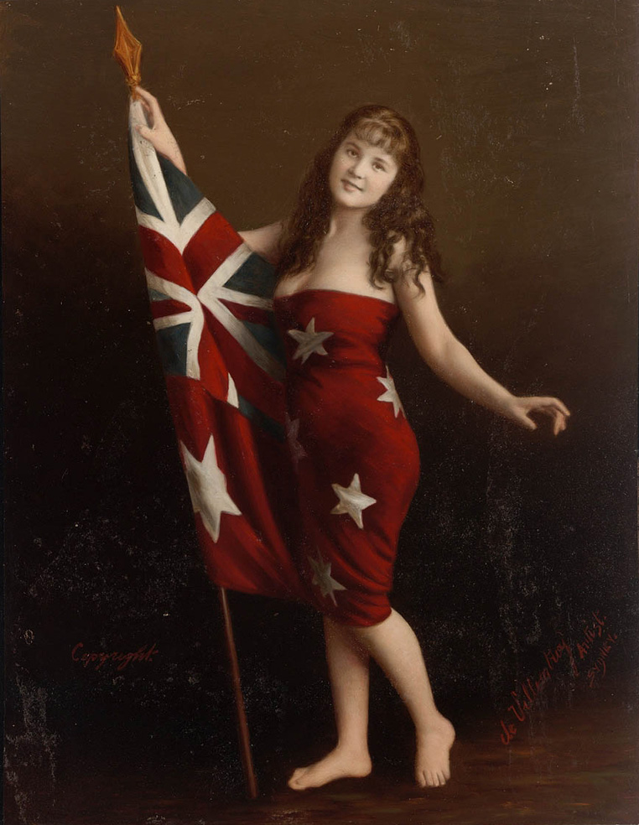
Story 2: the de Villentroy family
The story continues with Marie de Villentroy, Albert's daughter, who featured in his photo "Young Australia" (see right) and ran a French café before her marriage to Joseph Launay, a former baker and decorated sailor from WWII. Besides his medal and some correspondence between them, we also have letters confirming his acceptance as a permanent resident in Australia in January 1949.
This is just a snapshot of the journey all immigrants would have experienced, coming to Australia in this period.

Slide 13
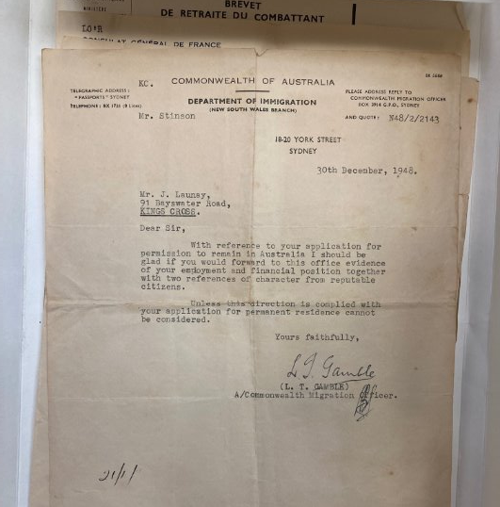
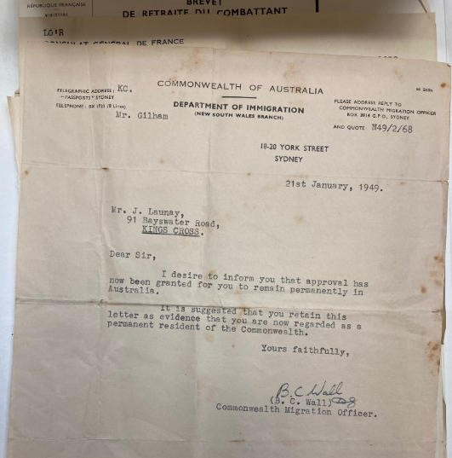

Slide 14
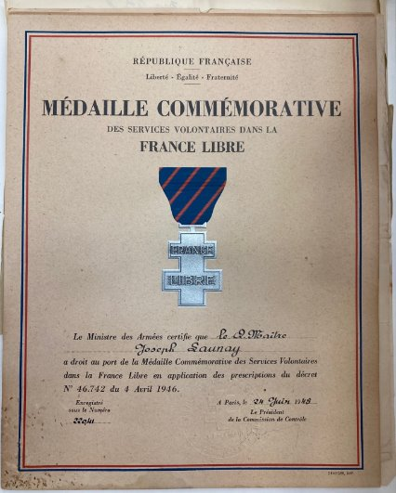

Slide 15
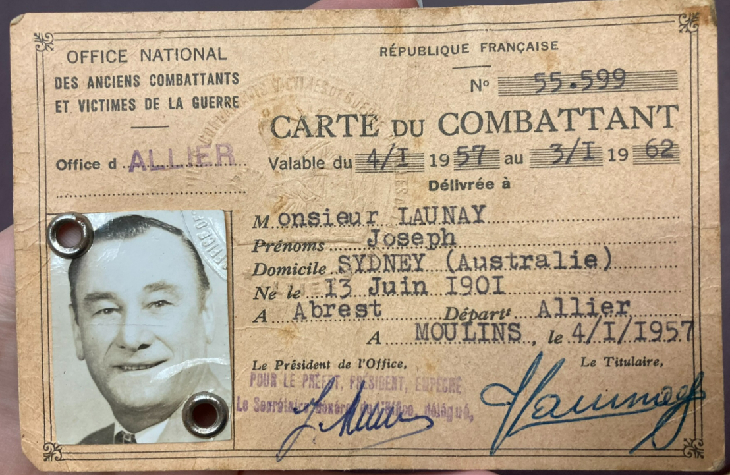

Slide 16
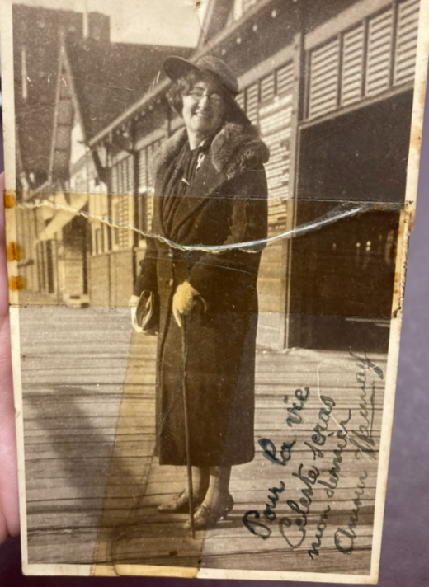

Slide 17
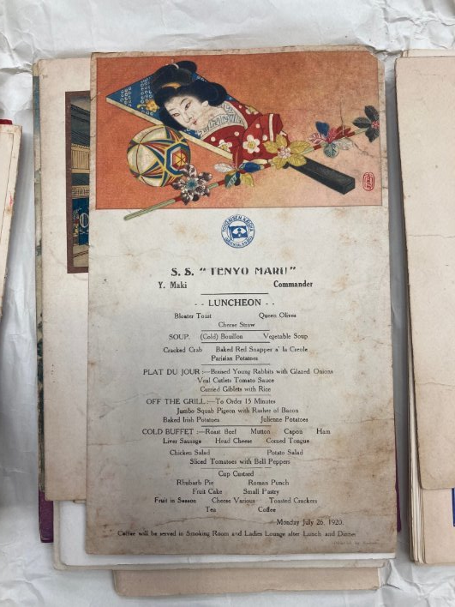
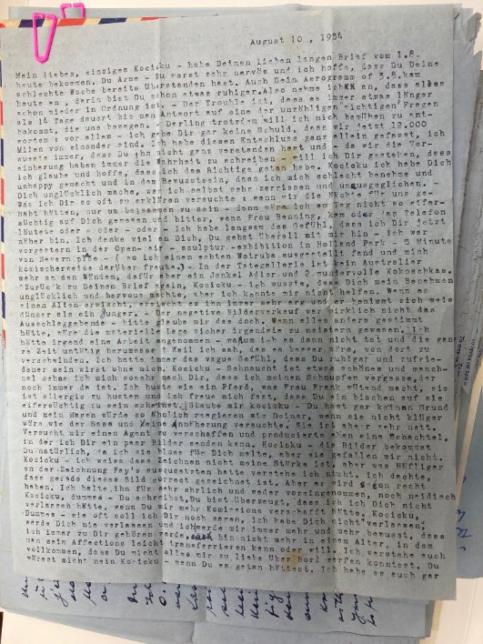
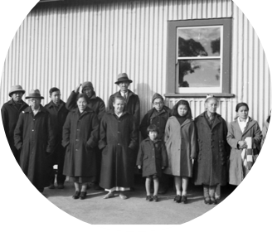
My pitch to listeners

Slide 18
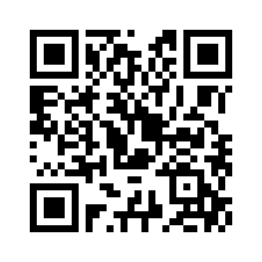
The full episode!

